Slide 1
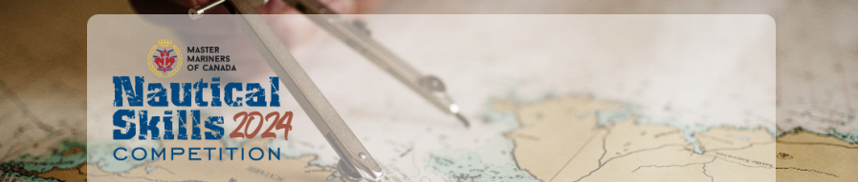
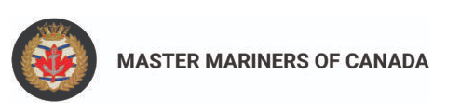


NAUTICAL SKILLS
COMPETITION 2024
Teams Kick Off & Exercise Overview

Slide 2
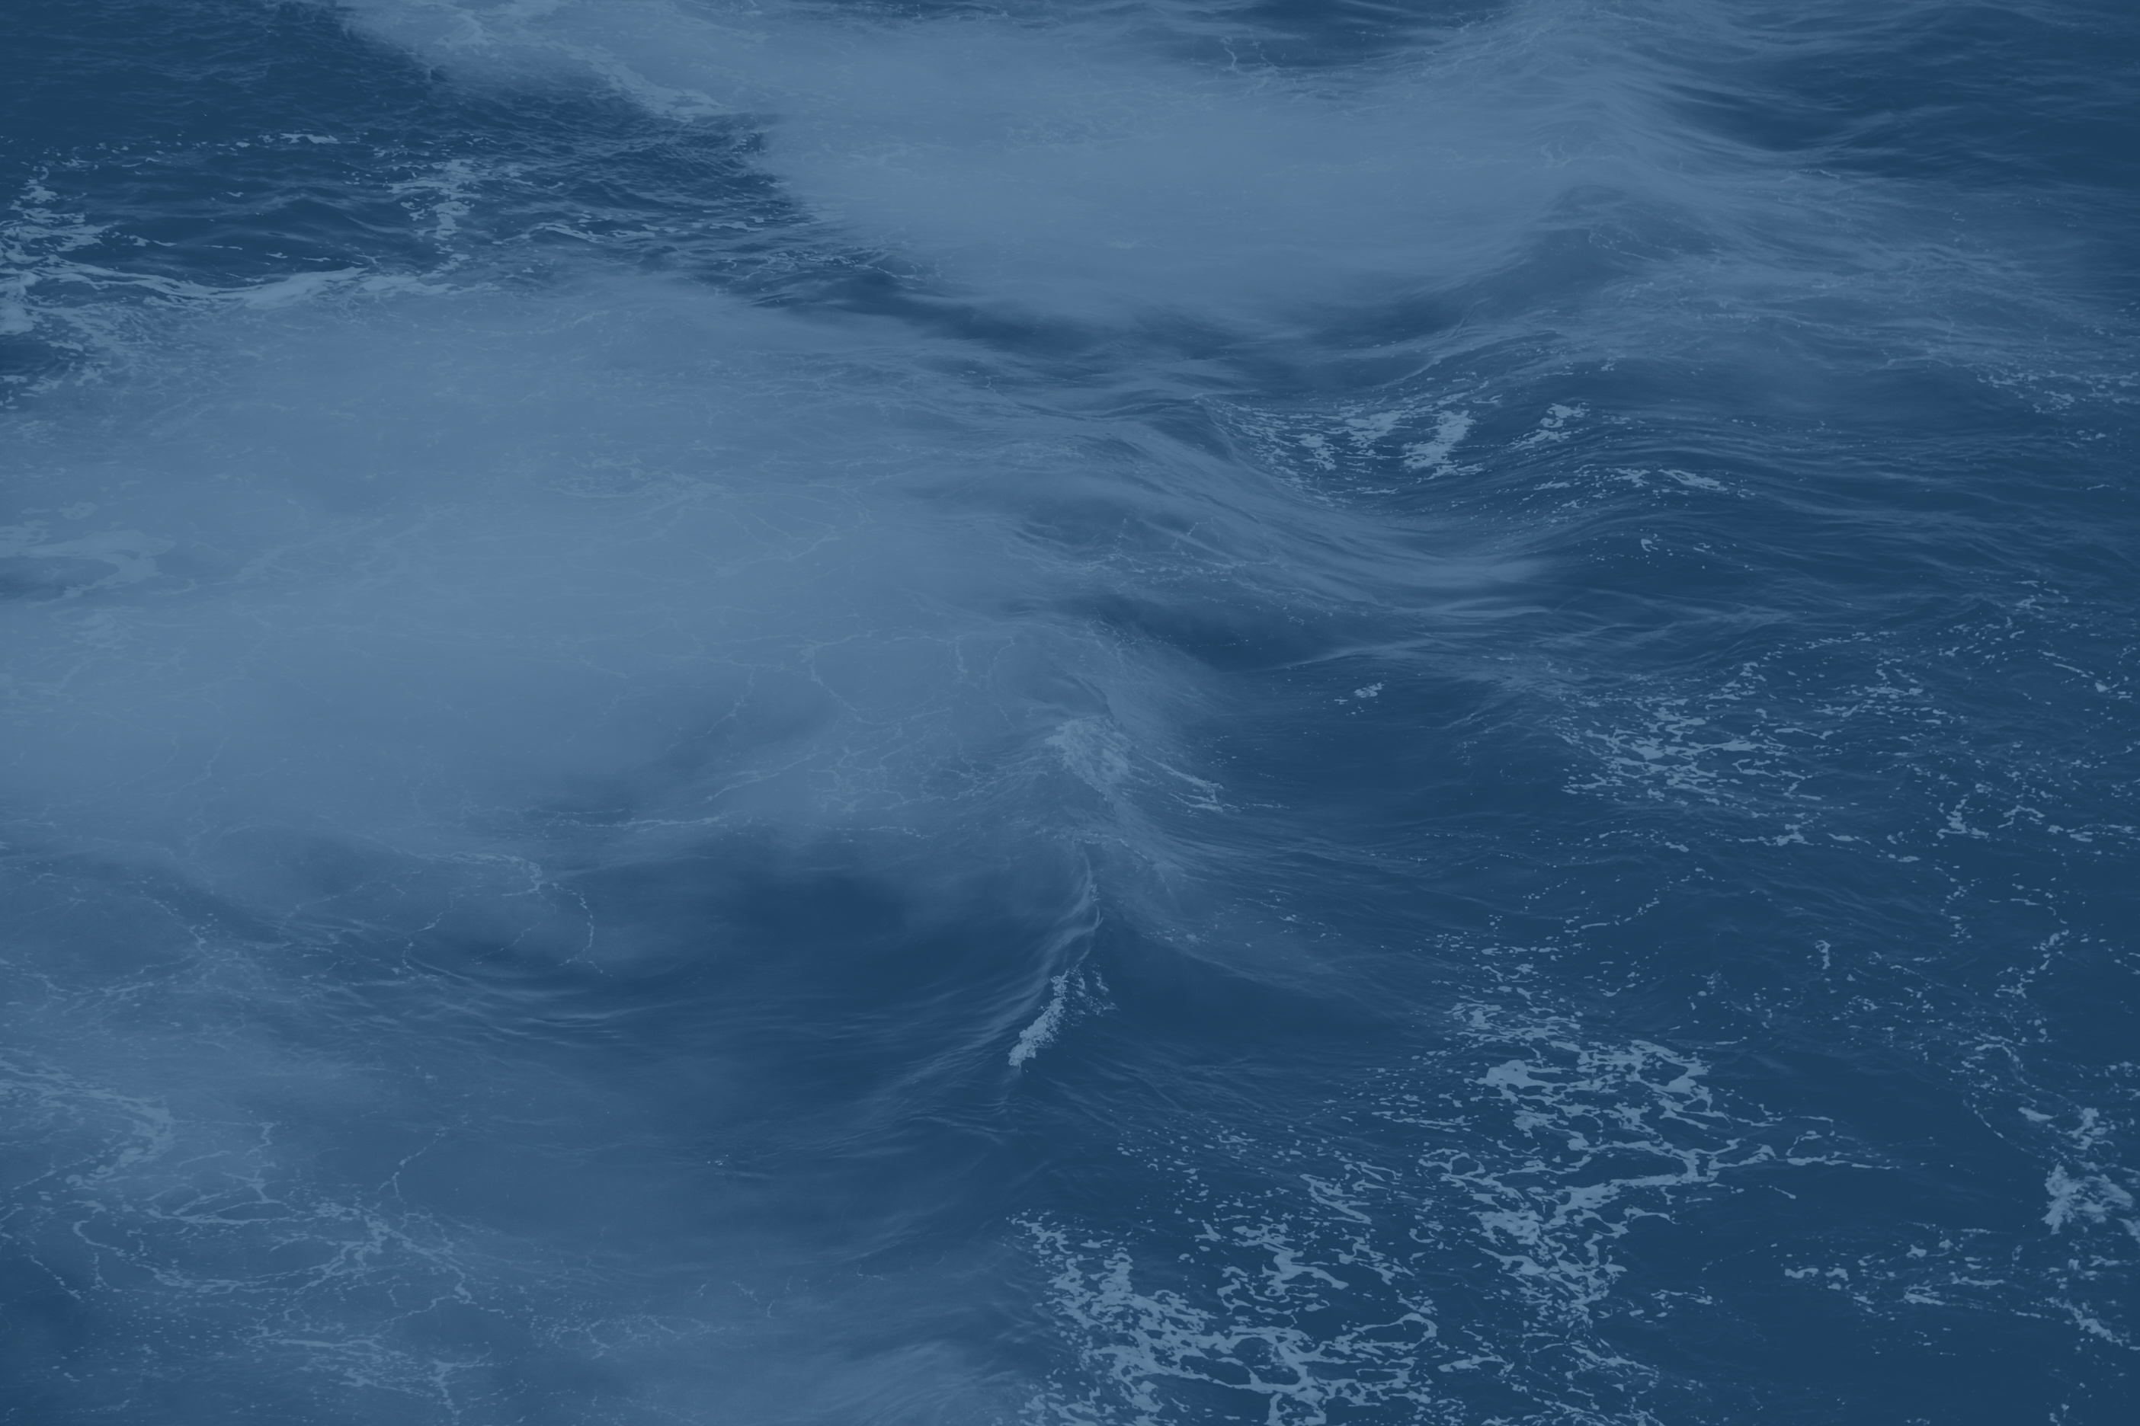

Master Mariners of Canada
Who are we?
  A national, not-for-profit association representing command-qualified master mariners, like-minded seafarers, industry members, and cadets across the country. Our organization takes official positions on important issues to ensure safety and to protect seafarers’ rights wherever they are working
  Our work focuses on three main pillars:
    building awareness
    supporting education
    upholding advocacy

Slide 3
Master Mariners of Canada
What is the Nautical Skills Competition?
  Started in 2012 as a way for the MMC NL Division to promote the maritime sector, encourage team building and professionalism, and to foster a culture of safety to the younger generation of upcoming seafarers
  It has become one of the largest and most successful events in the Division’s annual calendar
  The 1st place winners of the Nautical Skills Competition are presented with a Plaque named in honor of Captain Jim Thorpe (R. James Thorpe). The plaque honors the memory of this lifelong respected and professional mariner

Slide 4
Competition Rules
General Rules:
  Only four members of your team can participate in any one exercise, the other members can observe but cannot assist
  A 1st, 2nd, and 3rd year student must participate in every exercise
  Every team member must participate in at least one exercise
  1-2 minute safety moment is required at the start of every exercise
    Each safety moment must be applicable to the exercise in which you are competition
    Every team member must participate in at least one safety moment
  The exercise begins after completion of the safety moment; teams have 45 minutes to complete the task(s)
  TEAM NAMES – WHEN you create a team name please email it, along with your team number to nsc@mastermariners.ca

Slide 5
Exercises
Each team will be required to compete in 7 different exercises, which comprise the following marine-related areas:
  Dynamic Positioning
  Seamanship
  Emergency Management
  Offshore Operations
  Shiphandling / Navigation
  Search and Rescue
  Marine Emergency Duties

Slide 6
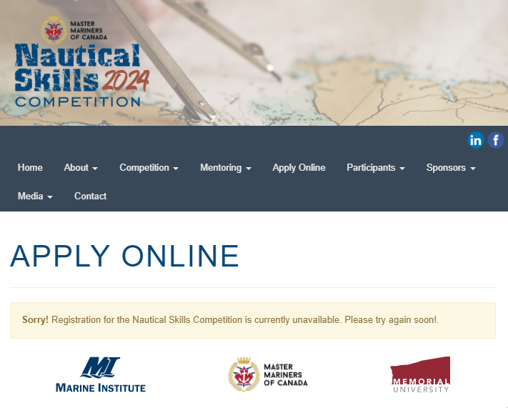


DYNAMIC POSITIONING
Participating teams will be challenged to:
  This exercise will take place on a multi-purpose support vessel (MSV)
  The vessel is required to follow a remotely operated vehicle (ROV), as it does an inspection of cables running between wind turbines, at an offshore windfarm
  The exercise will start with the vessel already on DP
  Before exercise start, the participants will select (from a predefined list) where they wish to start the exercise. The objective being to place the vessel where the maximum amount of cable inspection can be completed, in the exercise time available. Part of the overall score will be based on the total amount of cable inspected by each team
  Compromising safety protocols, to achieve extra distance, will result in lost marks
  There will be other vessels in the vicinity
  DP, joystick, manual levers, radar, radios, electronic chart, navigation lights, sound signals, etc. will all be available and expected to be used, as required
References
  DP System Manual Chapter (USB Stick) to be picked up at CMS W2104
Exercise location:
Heritage Bridge Simulator
(Main floor – CMS)
Exercise Lead: Captain Glenn Fiander
Glenn.Fiander@mi.mun.ca
Office: CMS W2104
Notes:
Short- Video 4:58

Slide 7
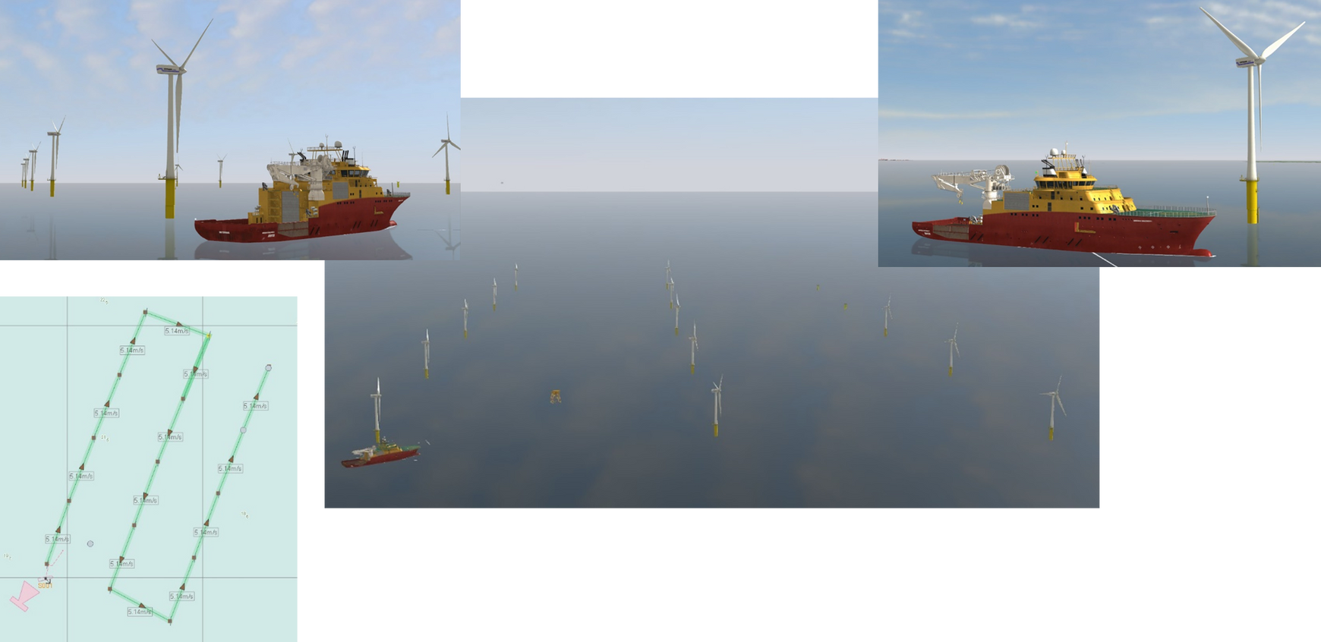
DYNAMIC POSITIONING
Exercise location:
Heritage Bridge Simulator
(Main floor – CMS)
Exercise Lead: Captain Glenn Fiander
Glenn.Fiander@mi.mun.ca
Office: CMS W2104
Notes:
Short- Video 4:58

Slide 8
SEAMANSHIP
Participating teams will be challenged to:
  Encode and decode messages using the signal flags of the International Code of Signals (INTERCO). One or more team members will select the correct flags to assemble the hoist and demonstrate the proper methods of securing flags to the halyard. One or more team members will read and record the message in the hoist. Team members will be judged on speed and accuracy of communication in this timed event
  Tie a heaving line knot (monkey fist), attach it to a heaving line, and throw the heaving line through the centre of a life ring. Team members will be judged on aesthetics of monkey fist, method of heaving line attachment, and accuracy of throw
  Demonstrate various knots, bends, hitches and splices and the proper use of various mooring line stoppers. Team members will be judged on accuracy of construction, and performance in a timed six-knot challenge
Exercise location:
Rigging Room
(First Floor- MI)
Exercise Lead: Captain Troy Nolan
troy.nolan@mi.mun.ca
Office: W3000A
Notes:
Short- Video 4:58

Slide 9
SEAMANSHIP
Participating teams will be challenged to (continued):
  Assemble items for working aloft or over the ship’s side; rig various purchases and discuss/demonstrate the use of this equipment. Team members will be judged on accuracy of rigging and knowledge of usage with particular emphasis on safety
  Identify various light and shape displays indicating a vessel’s type, navigational status or operational condition, along with various elements of the IALA Maritime Buoyage System – Region ‘B’. Team members will be judged on accuracy of identification in this timed event
Exercise location:
Rigging Room
(First Floor- MI)
Exercise Lead: Captain Troy Nolan
troy.nolan@mi.mun.ca
Office: W3000A
Notes:
Short- Video 4:58

Slide 10
SEAMANSHIP
Information and Resources
  Monkey Fist
  Bowline
  Bowline on the Bight
  Running Bowline
  Water Bowline
  Spanish Bowline Knot
  Carrick Bend
  Alpine Butterfly Loop
  Sheet Bend - one way, a.k.a. Tucked Sheet Bend
  Double Sheet Bend
  Fisherman’s Bend
  Fisherman’s knot
  Reef Knot
  Jury Mast Knot
  Figure 8 Loop
  Timber Hitch
  Rolling Hitch
  Constrictor Hitch
  Cow Hitch
  Highwayman’s Hitch
  Stoppers: Common Rope Stopper; West Country Stopper
  Splices (Three- Strand): Short splice; Long Splice; Eye Splice; Back Splice
  Working Aloft: Bosun’s Chair Hitch; Stage Hitch; Scaffold Hitch
  Rigging Purchases: Two-fold; Three-fold; Gyn Tackle
Exercise location:
Rigging Room
(First Floor- MI)
Exercise Lead: Captain Troy Nolan
troy.nolan@mi.mun.ca
Office: W3000A
Notes:
Short- Video 4:58

Slide 11
SEAMANSHIP
References
  Seamanship Techniques, D.J. House
  http://www.seasources.net/PDF/PUB102.pdf (INTERCO pp. 3, 6-8, 9sect.6, 22-23, Chapters 2&3)
  One representative from each team can pick up a hard copy of INTERCO from Capt. Ennis.
  http://www.surreyknots.org.uk/igkt-knot-charts.htm
  https://www.youtube.com/watch?v=O6Xc9RlL2g0
  https://paperzz.com/doc/8757468/rigging-stages--bosun-s-chair--and-rope-ladders
  http://www.animatedknots.com/index.php?LogoImage=LogoGrog.png&Website=www.animatedknots.com
Exercise location:
Rigging Room
(First Floor- MI)
Exercise Lead: Captain Troy Nolan
troy.nolan@mi.mun.ca
Office: W3000A
Notes:
Short- Video 4:58

Slide 12
EMERGENCY MANAGEMENT
Participating teams will be challenged to:
  Participants will be given a situation as if they were onboard a vessel navigating a coastal area in ice infested waters.
  They will encounter a marine emergency requiring them to respond yet maintain the safety of their vessel.
  Participants will be required to effectively manage the emergency and carry out a review of their own condition to verify they are still seaworthy.
  A stability or cargo calculation may be included that could affect the choices of action for the emergency.
  The Emergency Incident usually is usually based something that has happened within the past year.
Exercise location:
SEN Simulator
(Third floor – MI)
Exercise Lead: Captain Victor March
Victor.March@mi.mun.ca
Office: W2112 (CMS)
Notes:
Short- Video 4:58

Slide 13
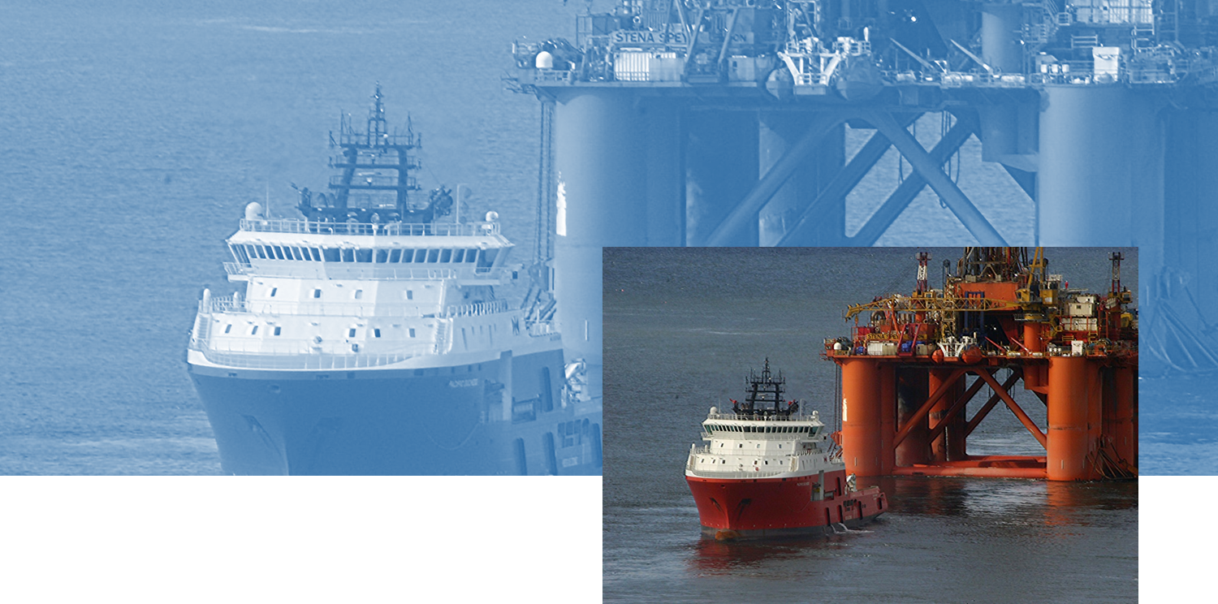
OFFSHORE OPERATIONS
Anchor Handling: Introduction
Exercise location:
Offshore Operations Simulator
(Main floor – CMS)
Exercise Lead: Captain Eben March
Ebenezer.March@mi.mun.ca
Office: CMS Offshore Operations Bld
Notes:
Short- Video 4:58

Slide 14
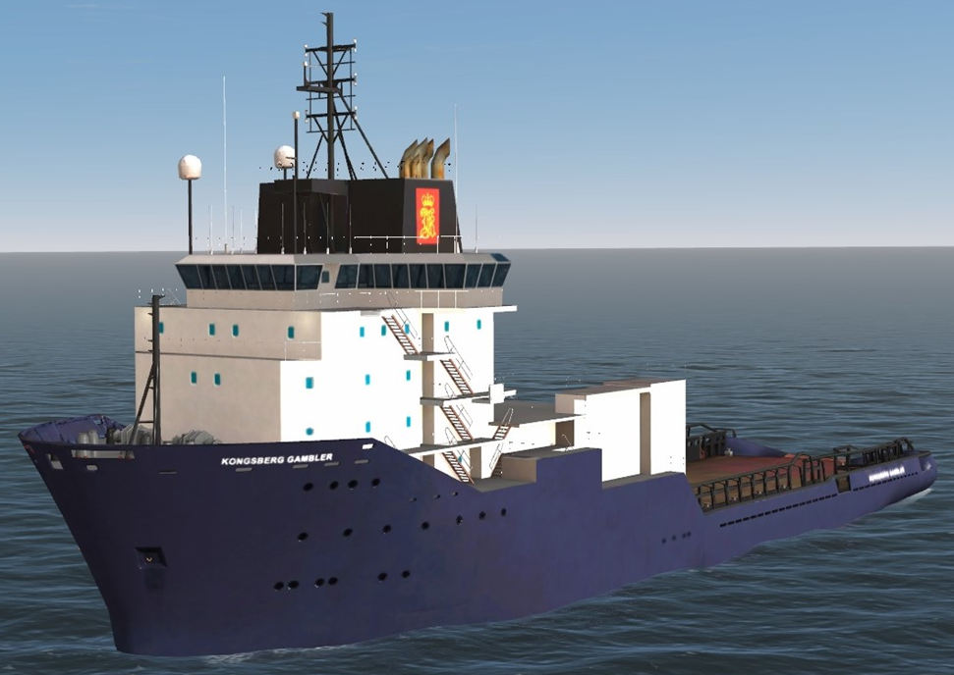
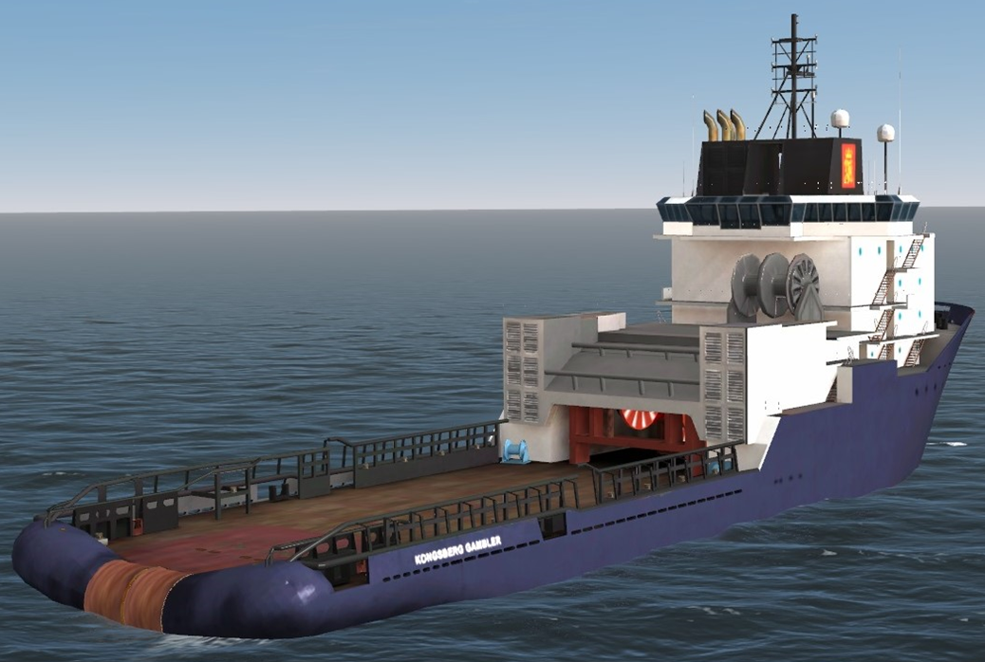
OFFSHORE OPERATIONS
AHTS Gambler
Exercise location:
Offshore Operations Simulator
(Main floor – CMS)
Exercise Lead: Captain Eben March
Ebenezer.March@mi.mun.ca
Office: CMS Offshore Operations Bld
Notes:
Short- Video 4:58

Slide 15
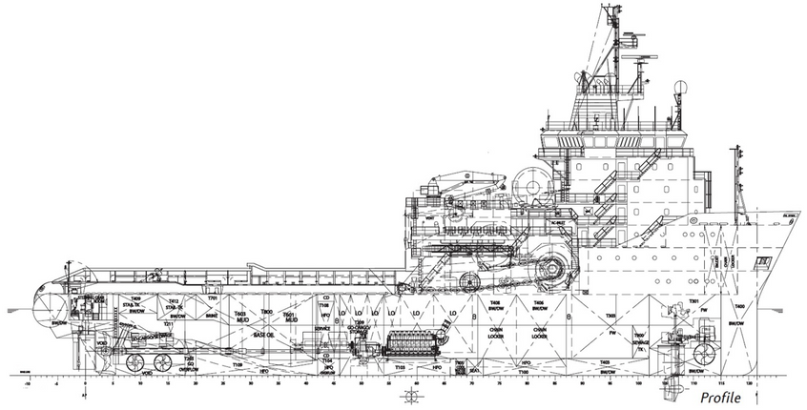
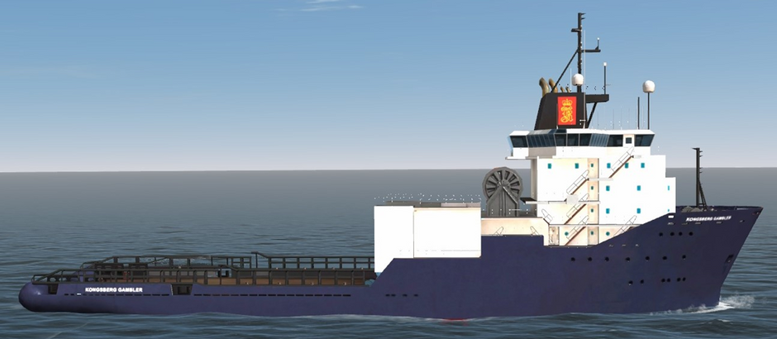
OFFSHORE OPERATIONS
AHTS Gambler
Exercise location:
Offshore Operations Simulator
(Main floor – CMS)
Exercise Lead: Captain Eben March
Ebenezer.March@mi.mun.ca
Office: CMS Offshore Operations Bld
Notes:
Short- Video 4:58

Slide 16
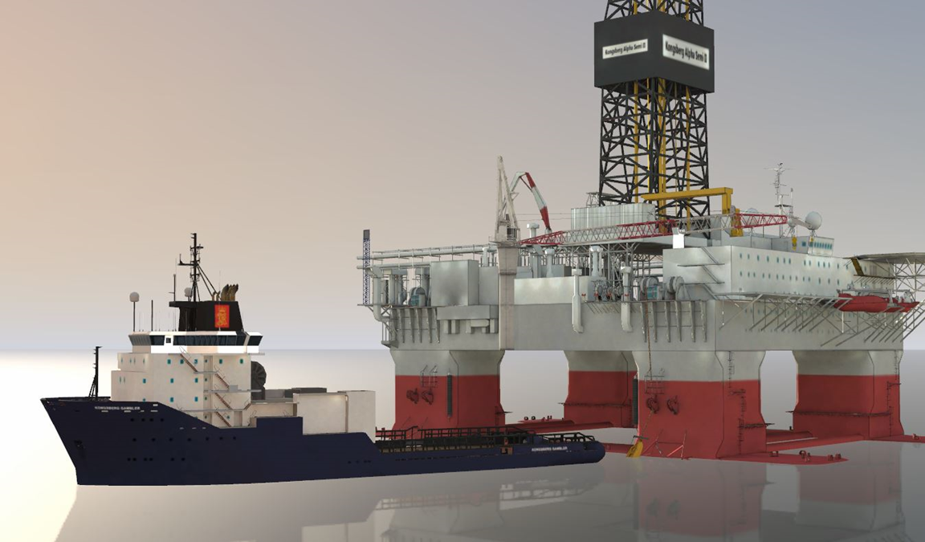
OFFSHORE OPERATIONS
Vessel Backed in to Pick up Anchor
KONGAM-v1.0-Mar.2023
Exercise location:
Offshore Operations Simulator
(Main floor – CMS)
Exercise Lead: Captain Eben March
Ebenezer.March@mi.mun.ca
Office: CMS Offshore Operations Bld
Notes:
Short- Video 4:58

Slide 17
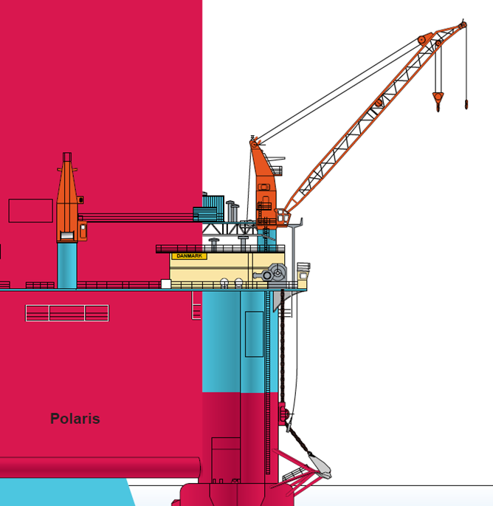
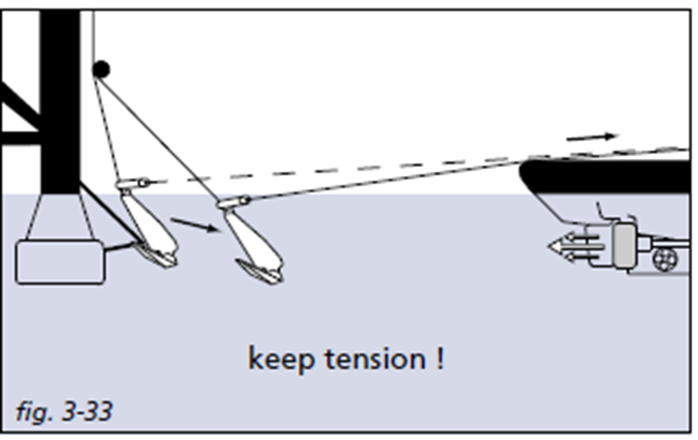
OFFSHORE OPERATIONS
Steps for Anchor Handling
Exercise location:
Offshore Operations Simulator
(Main floor – CMS)
Exercise Lead: Captain Eben March
Ebenezer.March@mi.mun.ca
Office: CMS Offshore Operations Bld
Notes:
Short- Video 4:58

Slide 18
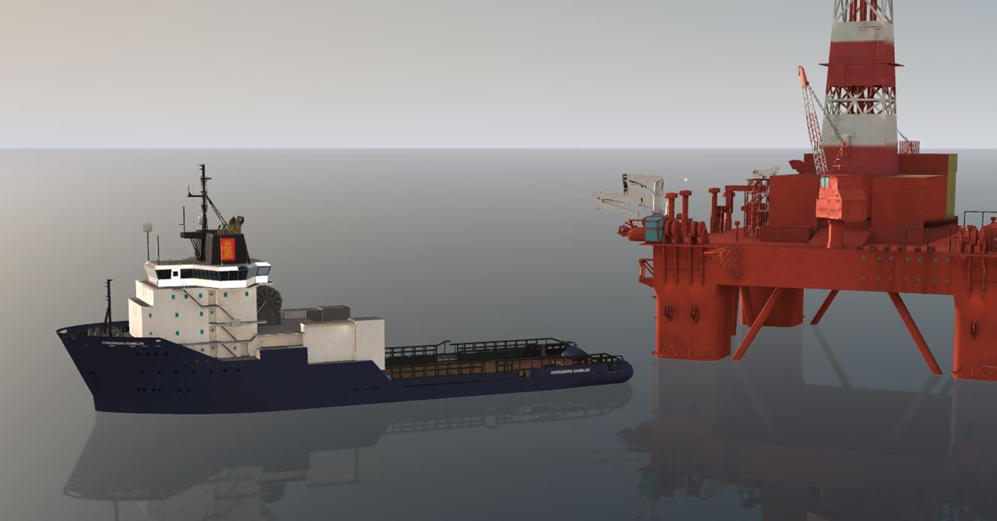
OFFSHORE OPERATIONS
Vessel Ready to pull out Anchor
KONGAM-v1.0-Mar.2023
Exercise location:
Offshore Operations Simulator
(Main floor – CMS)
Exercise Lead: Captain Eben March
Ebenezer.March@mi.mun.ca
Office: CMS Offshore Operations Bld
Notes:
Short- Video 4:58

Slide 19
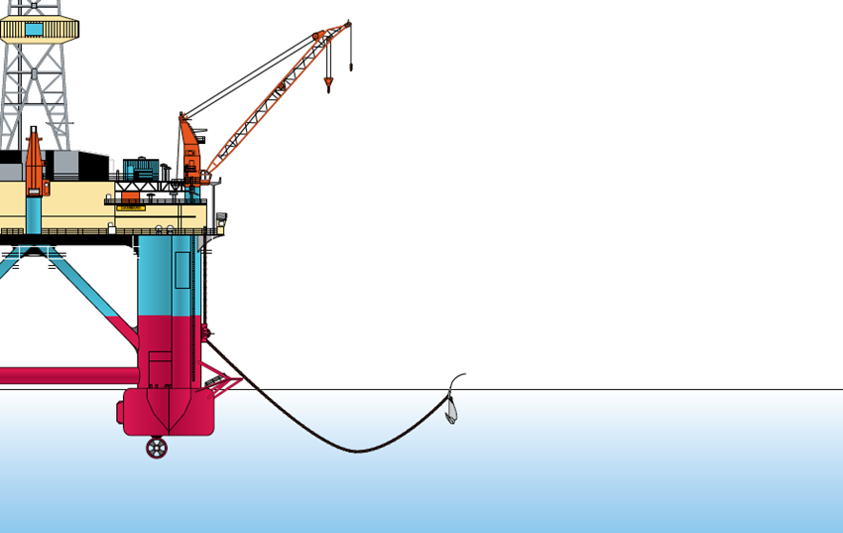
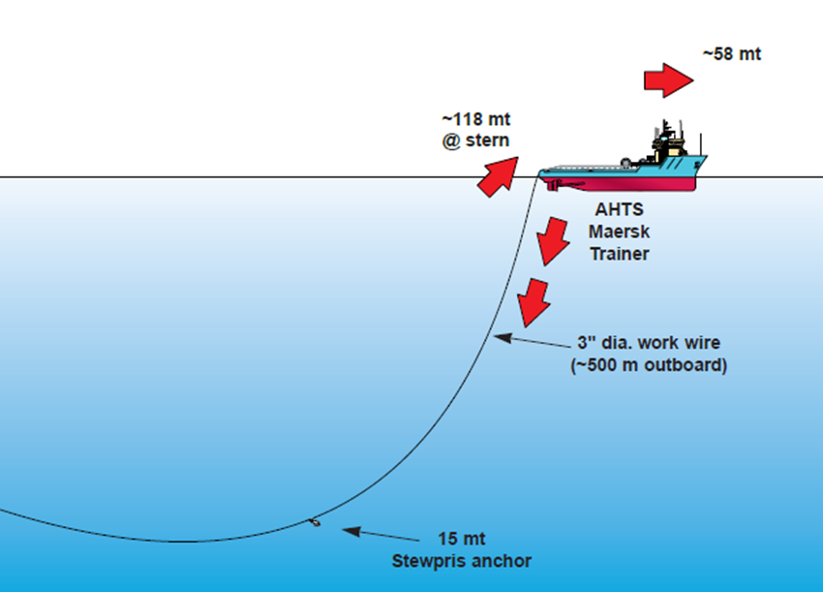
OFFSHORE OPERATIONS
Pulling out the Anchor
Exercise location:
Offshore Operations Simulator
(Main floor – CMS)
Exercise Lead: Captain Eben March
Ebenezer.March@mi.mun.ca
Office: CMS Offshore Operations Bld
Notes:
Short- Video 4:58

Slide 20
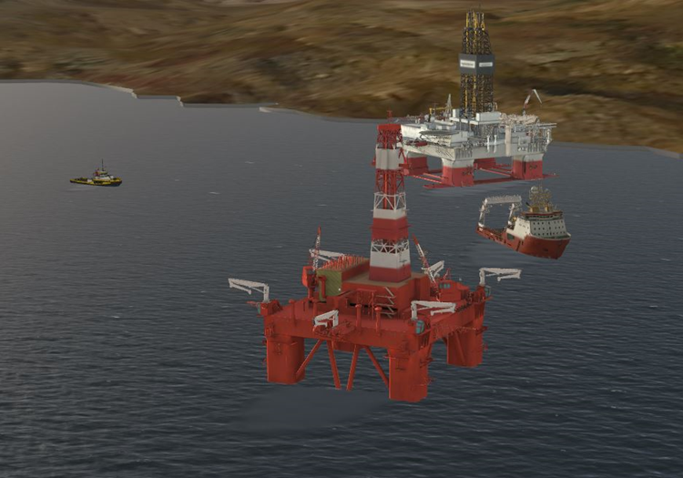
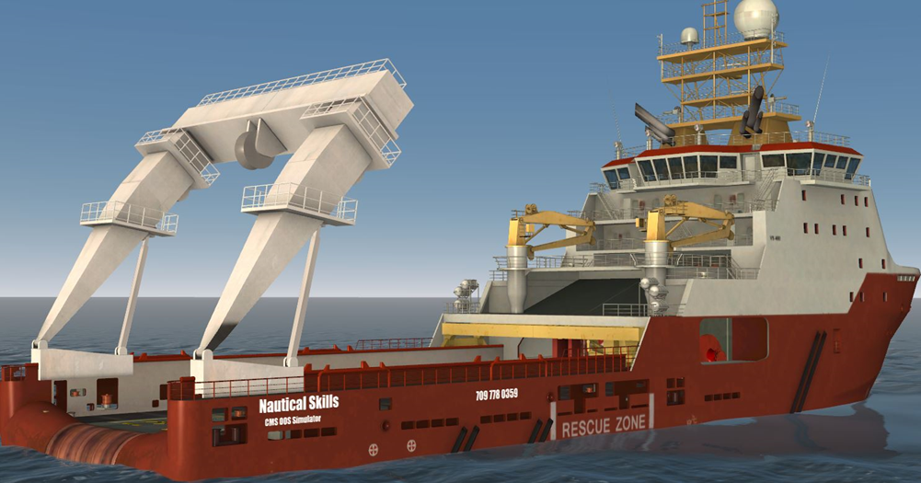
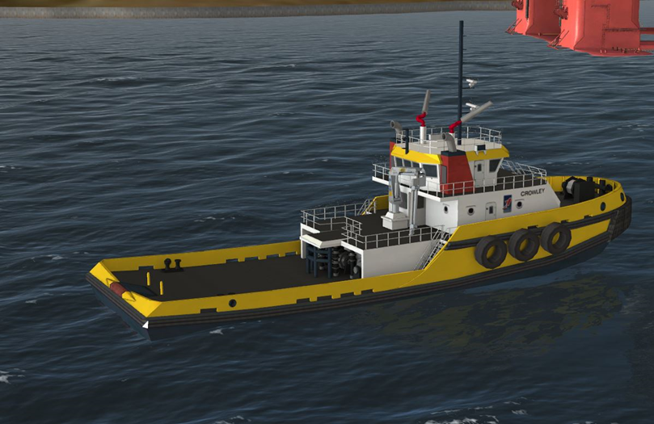
OFFSHORE OPERATIONS
Exercise location:
Offshore Operations Simulator
(Main floor – CMS)
Exercise Lead: Captain Eben March
Ebenezer.March@mi.mun.ca
Office: CMS Offshore Operations Bld
Notes:
Short- Video 4:58

Slide 21
SHIPHANDLING / NAVIGATION
Participating teams will be challenged to:
  Teams will be required to maneuver and navigate their ship within Belfast Harbour to enter the Main Dry Dock
  Teams are to maneuver their ship safely into the turning basin and turn the vessel to proceed outward into the harbour. They must then turn the ship again and back down the channel towards the dry dock
  The vessel will be initially positioned with the bow facing inward. To complete the exercise the vessel must be berthed port side to the dry dock wall with the bow facing outward
  The vessel must maneuver safely into the turning basin turned through 180 degrees then safely maneuvered back down into the dry dock. At all times safe navigation, communications, bridge teamwork and situational awareness will be critical
References
  International Chamber of Shipping Bridge Procedures Guide
  Danton’s The theory and practice of Seamanship, sections related to ship handling
  DJ House Seamanship Techniques, section related to ship handling
  Collision Regulations, appropriate to navigational safety and detection or targets and action to avoid collision
Exercise location:
Full Mission Bridge Simulator (Bottom floor – CMS)
Exercise Lead: Captain Chris Hearn
Christopher.Hearn@mi.mun.ca
Office: CMS W2100
Notes:
Short- Video 4:58

Slide 22
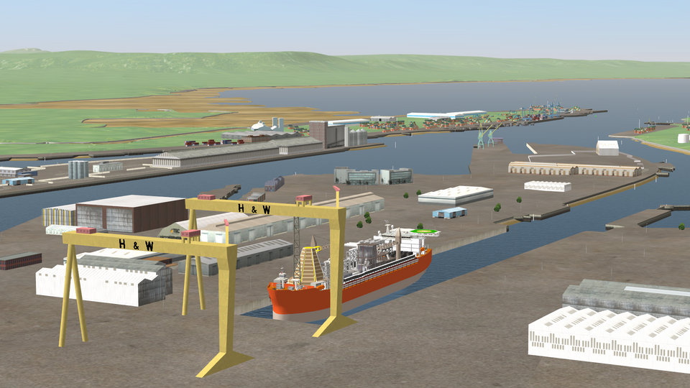
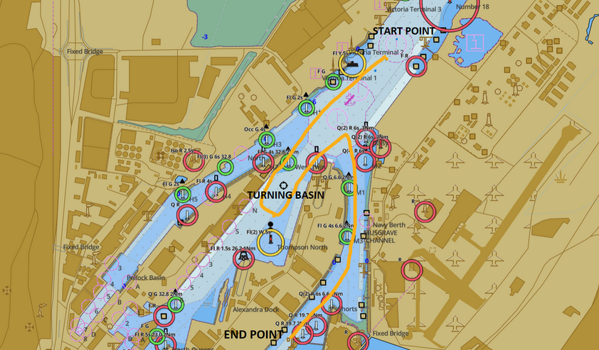
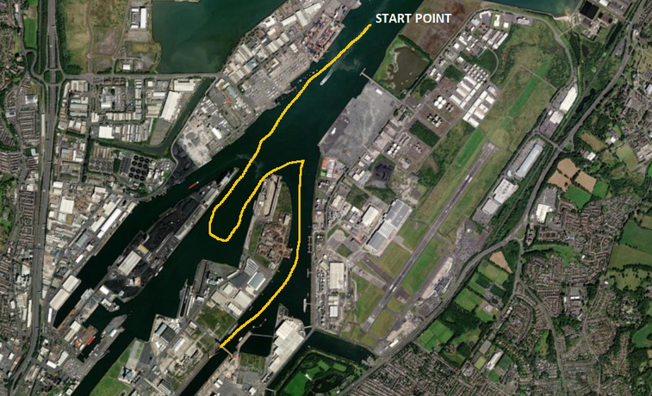
SHIPHANDLING / NAVIGATION
Exercise location:
Full Mission Bridge Simulator (Bottom floor – CMS)
Exercise Lead: Captain Chris Hearn
Christopher.Hearn@mi.mun.ca
Office: CMS W2100
Notes:
Short- Video 4:58

Slide 23
SEARCH AND RESCUE
Exercise location:
First Floor of OOS Building
Exercise Lead: Captain Anthony Patterson
Anthony.Patterson@virtualmarine.ca
Notes:
Short- Video 4:58

Slide 24
MARINE EMERGENCY DUTIES
Participating teams will be challenged to:
On the Friday evening of the Competition weekend...
A relay and competition for time:
  Part A: Don a Fire Suit/ Bunker Gear
  Part B: Attach a fire nozzle and deploy hose
  Part C: Drag hose to where rescue manikin is located
  Part D: Drag rescue manikin to safe area (back where you started)
  Part E: Don an immersion suit and a second student dons a life jacket. Student in Immersion suit activates EPIRB and student in life jacket throws rescue quoit at a target
Exercise location:
MI GYM
Captain Glenn Fiander Glenn.Fiander@mi.mun.ca
Office: CMS W2104
Captain Eben March
Ebenezer.March@mi.mun.ca
Office: CMS Offshore Operations Bld
Notes:
Short- Video 4:58

Slide 25
FAMILIARIZATION SESSION
Simulator Familiarization Session:
  Thursday, February 1st from 5:30PM to 7:30PM – maximin of two members per team allowed at each exercise session in the location the exercise will be held during the competition (unless alternative location is identified by exercise lead).
    1st session from 5:30PM to 6:30PM
    2nd session from 6:30PM to 7:30PM
Locations:
  Dynamic Positioning Exercise – Heritage Bridge Simulator (Main floor – CMS)
  Shiphandling/Navigation Exercise – Full Mission Bridge Simulator (Bottom floor – CMS)
  Offshore Operations Exercise – Offshore Operations Simulator (Main floor – CMS)
  Emergency Management Exercise – SEN Simulator (Third floor – MI)
  Search and Rescue Exercise – First Floor of OOS Building
  Seamanship Exercise – Rigging Room (First Floor- MI)
Notes:
Short- Video 4:58

Slide 26
Competition
Friday, February 9th from 5PM to 8:30 PM
  5PM to 6PM - registration, food, and briefing in the cafeteria
  6PM to 7:30PM - Marine Emergency Duties Exercise in the gymnasium
  7:30PM to 8:30PM - Simulator Familiarization Session
Saturday, February 10th ALL DAY
  Competition starts at 8:00AM
  7:30PM - Gala dinner in the cafeteria

Slide 27
Awards
1st Place: $2000 per team member and Names on Captain Jim Thorpe Plaque
Other Awards:
  Safety
  Spirit
  Professionalism
  Communication and Teamwork
  Honourable Mention
  Achievement in Problem Solving
2nd Place: $750 per team member
3rd Place: $500 per team member

Slide 28

NEXT STEPS
  Plan and prepare
  Attend Familiarization Session
  Have Fun!
QUESTIONS?
Nautical Skills Competition Coordinator
Tel: (709) 778-0339
Email: nsc@mastermariners.ca
Notes:
Short- Video 4:58

Slide 29
NAUTICAL SKILLS
COMPETITION 2024

